Slide 1





TITLE : Design of a bias tee
Presented by :
KAVIMANI K 927622BEC094
LOGESHWARAN J 927622BEC102
MANOJ M.T 927622BEC114 GUIDED BY
MOHANAPRASATH K.R 927622BEC121 Mrs.Sentamilselvi

Slide 2
Objectives
To design and simulate a broadband bias tee that operates efficiently across a frequency range of 100 MHz to 15 GHz.
To achieve low insertion loss, high DC-RF isolation, and good impedance matching in RF systems.
To validate the design using Ansys HFSS simulation and identify areas for optimization.

Slide 3
LITERATURE SURVEY
Author(s) | Year | Title | Key Contributions | Gaps Identified
S. Kumar, A. Gupta, and R. Patel | 2018 | Design and Optimization of Broadband Bias Tee for RF Applications | Optimized bias tees using high-Q inductors and capacitors. Achieved low insertion loss and high isolation | Limited performance at low frequencies.
R. Singh and P. Verma | 2020 | Simulation and Testing of High-Frequency Bias Tee Using HFSS | Highlighted the importance of HFSS simulations for bias tee design. Emphasized accurate S-parameter analysis. | Challenges in achieving consistent broadband performance

Slide 4
Author(s) | Year | Title | Key Contributions | Gaps Identified
H. Wang and J. L | 2020 | A Compact Bias Tee with High DC-RF Isolation for RF Power Systems | Developed a compact design with high isolation for RF power systems. Maintained low insertion loss and compact size. | Limited focus on broadband operation for lower bands.
M. Y. Kim and S. H. Lee | 2020 | Design of Wideband Bias Tee Using Microstrip Components | Used microstrip technology for wideband bias tee design. Achieved better signal integrity and minimal interference. | Practical implementation challenges remain unaddressed

Slide 5
Abstract
The design of a broadband bias tee was simulated using Ansys HFSS.
The system operates from 100 MHz to 15 GHz, combining RF and DC signals while ensuring minimal interference.
Key performance metrics include return loss (S11), insertion loss (S21), and isolation (S12).
Simulation results indicate good performance at higher frequencies, with optimization required for lower frequencies.

Slide 6
BLOCK DIAGRAM
RF signal input
DC signal input
Rf path
Dc path
Blocking dc
Isolates RF
Capacitor for
Dc blocking
Inductor for Rf isolation
Combined path

Slide 7
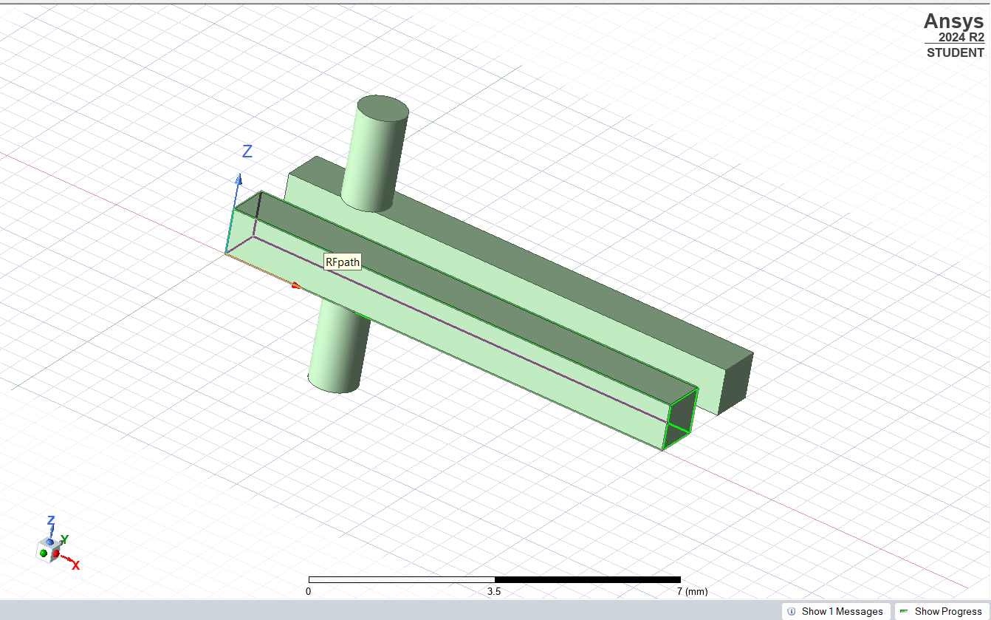
Design and requirements in HFSS
This design of bias tee in hfss and its componensts are
Inductor: Blocks high-frequency RF signals in the DC path
Capacitor: Blocks DC signals in the RF path

Slide 8
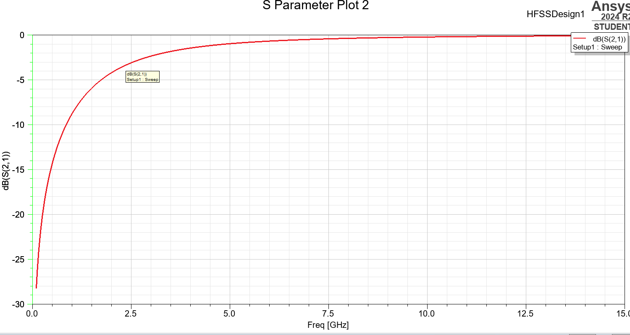
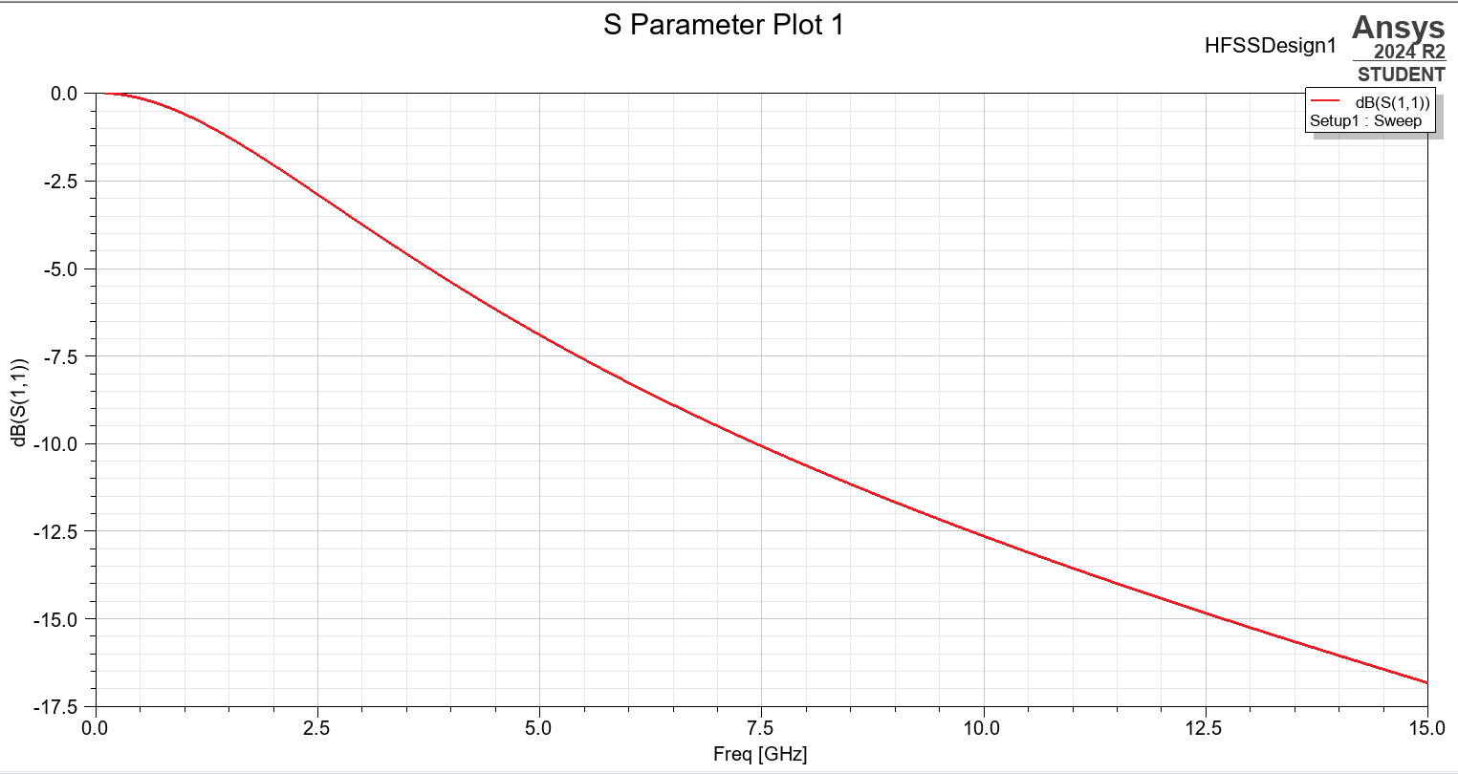
SIMULATION RESULTS
The insertion loss (S21) showed a gradual increase as the frequency approached higher values
The return loss (S11) showed values that improved with increasing frequency

Slide 9
Applications of Bias Tee
Powering active antennas in RF systems.
Transmitting RF signals in wireless communication (e.g., mobile networks, Wi-Fi).
Supplying DC power to RF power amplifiers.
Combining DC and RF signals in microwave systems.
Biasing test devices in measurement equipment.
Injecting DC signals into RF signal paths for control.

Slide 10


